Slide 1
Equity considerations in the Green Deal: A modelling perspective
Toon Vandyck
June 2021

Slide 2
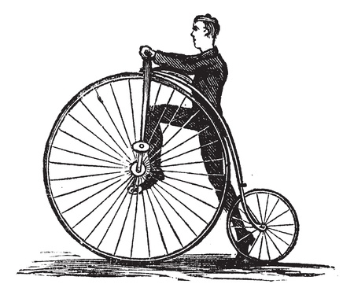
Climate policy, fast & slow
?
Notes:
Vs. Leave no one behind

Slide 3
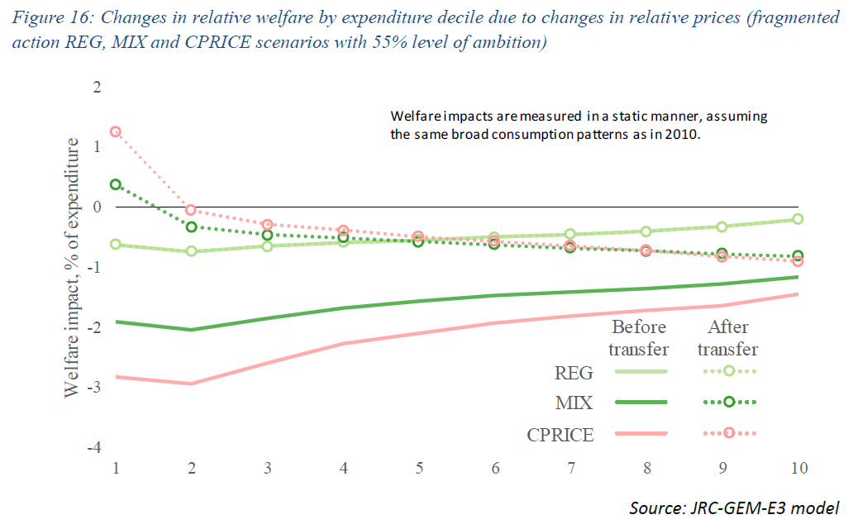
1. Fairness & optimal instrument choice
Prices, regulation, subsidies?
Offsetting regressive impacts through use of revenues
Expenditure- vs income-side
EC (2020). Impact Assessment of the 2030 Climate Target Plan
Notes:
1/ Prices are regressive, BUT: subsidies solar panels, electric vehicles (JAERE paper, company cars)
2/ lump sum vs labour vs EICT
3/ jobs: sector- and region-specific --- income side matters but the debate cannot stop there (next slide)

Slide 4
2. Beyond income: Horizontal equity
3 SCENARIOS
RICH
POOR
Temursho, U., Weitzel, M. and Vandyck, T. (2020). Distributional impacts of reaching ambitious near-term climate targets, JRC Report
WORSE OFF
BETTER OFF
Notes:
JRC report; horizontal equity; commuters; income side; jobs; dimensions other than income matter

Slide 5
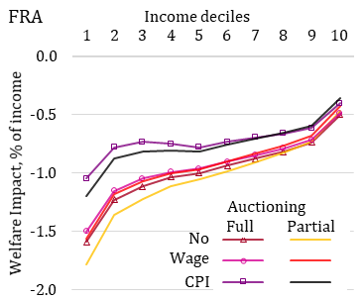
3. Policy interactions shape distributional outcome
Sensitivity of pre-revenue-recycling welfare impacts
Are social benefit systems ready to cushion impacts and protect the poor?
How do other policies come into play? Pubic investments, social housing, public transport, re-skilling, etc.
Vandyck et al. (2021), Energy Economics, forthcoming
Notes:
Environmental trade measures; social benefit system
What about CAP, Recovery and Resilience Plans

Slide 6
4. Unequal exposure, impacts and adaptation

Slide 7
4. Unequal exposure, impacts and adaptation
Notes:
Health-poverty trap
Labour productivity
Broader welfare metric

Slide 8
Concluding remarks
Ensuring that no one is left behind in the transition to a fair, competitive and climate-neutral economy requires a broad perspective on
Policy instruments for decarbonisation
Impact heterogeneity across households, sectors and regions
Stakeholder engagement across policy domains (miners, farmers)
Metrics of economic progress (incl. health)

Slide 9
Thank you Toon.Vandyck@ec.europa.eu @ToonV
© European Union 2021
Notes:
Conclusion:

