Slide 1
How to create fairer climate policies
JRC Fairness Community of Practice Webinar, 8 June 2021
Dr Milena Büchs & Dr Sylke V. Schnepf

Slide 2
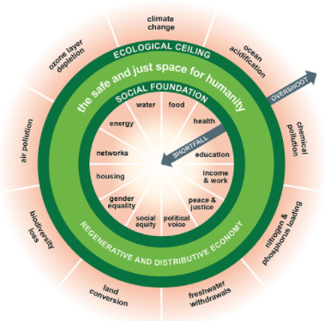
Introduction
Increasing awareness of the need to combine environmental and social objectives
Raworth (2017): “safe and just space for humanity”
Problem: some environmental policies have regressive distribution impacts – and hence are unpopular
What can policy makers do to counteract?
“Safe and just space for humanity”, Kate Raworth
Notes:
Picture credit: https://en.wikipedia.org/wiki/Doughnut_(economic_model)

Slide 3
Three policy proposals
Choose less regressive taxes
Compensate for regressive effects
Tackle top emitters - support the vulnerable
“Safe and just space for humanity”, Kate Raworth
Notes:
Picture credit: https://en.wikipedia.org/wiki/Doughnut_(economic_model)

Slide 4
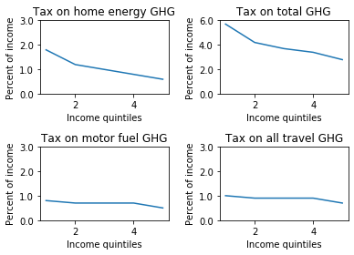
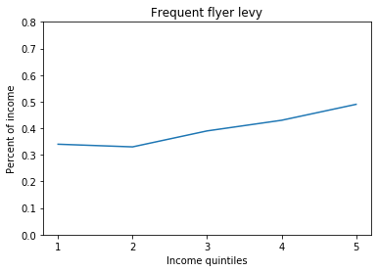
Carbon tax burdens
Average tax burden as per cent of household income of a €50 tax per tonne of CO2e across 24 EU countries. Data for tax graphs: EU HBS 2010, Exiobase. Data for FFL: UK Living Costs and Food Survey; DEFRA GHG conversion factors.

Slide 5
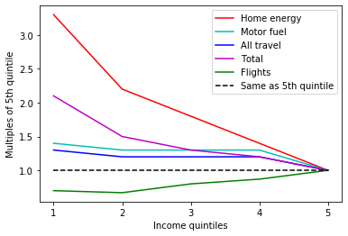
Multiple of the tax burden of 5th income quintile
Home energy taxes are most regressive
Taxes on motor fuel / all travel are less regressive
Taxes on flights are progressive
€50 tax per tonne of CO2e across 24 EU countries / UK for FFL
Data: EU HBS 2010, Exiobase; UK Living Costs and Food Survey 2014-2017/8

Slide 6
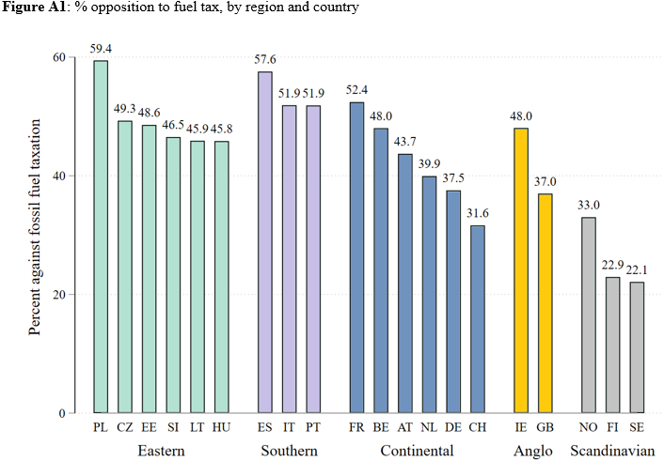
Opposition against fuel taxes
Source: ESS 2016, Germanwatch.org
Notes:
No clear tendency: environtmental factors not of great importance. Exception renewable energy – but this is driven by exceptional position of Finland, Sweden and Norway.
Be able to say something about this indecx!

Slide 7
Drivers of opposition
Data: European Social Survey 2016 / Eurostat
Analysis at the individual level (logistic regression) and country level:
Low income, fuel poverty, low education
No climate change worry & little trust in politicians

Slide 8
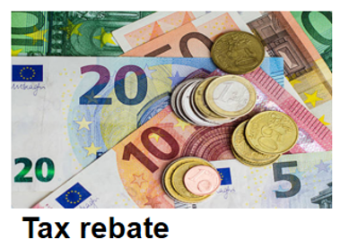
Compensation options
Cash compensation
Equal per capita tax rebates
Benefit system
“In-kind” compensation
Investment in green infrastructures, e.g. renewable electricity, home insulation, public transport → free provision of basic services
Green basic services or vouchers

Slide 9
Compensation options
 | Equal per capita tax rebates | Free green services
Distributional impacts | Progressive (especially for travel) | Progressive (especially for travel)
Emission reduction | Can be limited if spending is inelastic & few alternatives on the market | Higher potential for reduction because governments directly improve carbon footprint of provision
Fuel & transport poverty | Little impact because spending on fuel/transport remains similar | Greater reductions of fuel / transport poverty because spending reduces
Green basic services or vouchers

Slide 10
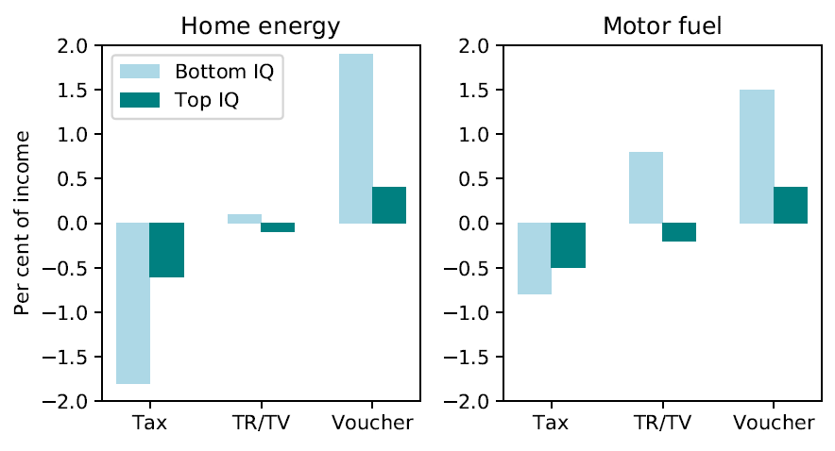
Distributional impacts
TR = Tax rebate
TV = Tax & voucher
Voucher = voucher only (no tax)

Slide 11
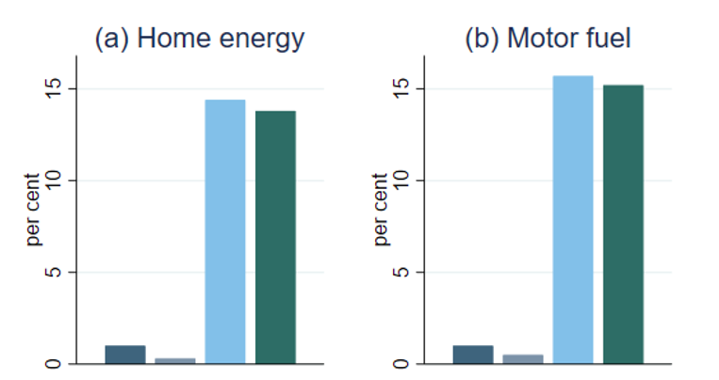
Emission reduction
Tax rebates nearly eliminate emission savings from taxes
Tax & vouchers:
Renewable electricity vouchers could save 95.5 MtCO₂e or 14% of home energy GHG
Public transport vouchers could save 116 MtCO₂e or 15% of motor fuel emissions
Caveats: Emission savings from green vouchers would need time to materialise & require prior funding for investments. We currently do not model substitution effects of the taxes
Data: EU HBS 2010 & Exiobase

Slide 12
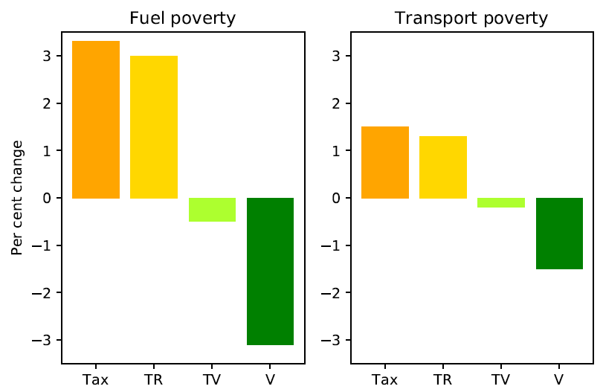
Fuel and transport poverty
Hills’ definition of fuel poverty: high cost (> equivalised median) and low income (below 60% median income after housing cost)
Transport poverty (Mattioli et al.): same definition but cost is > twice median spending
TR = Tax rebate
TV = Tax & voucher
V = Voucher only
Data: EU HBS 2010, Exiobase
Notes:
Definitions of fuel and transport poverty: Hills definition of low income, high cost: if household spends more than the equivalised median spending on home energy and twice the median on motor fuel; and if their income is below 60% of median income after housing cost.
The rebates influence income and hence lift some people out of the poverty definition, but spending on home energy / motor fuel remains the same. The latter is only addressed with the vouchers

Slide 13
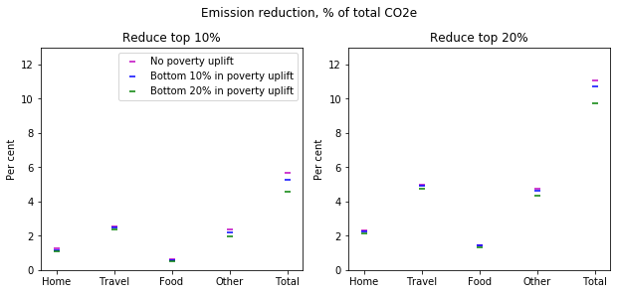
Reducing top emitters vs. lifting those in poverty up
Data: EU HBS 2010 & Exiobase

Slide 14
Consumption corridor scenarios
Assumed global carbon budget from 2018 onwards: 420GT (= 66% chance to stay below 1.5 degrees warming, IPCC 2018)
Data: EU HBS 2010 & Exiobase

Slide 15
Conclusions
Choose less regressive taxes: transport taxes less regressive; flight taxes progressive
Compensate for regressive effects: invest in green infrastructures & provide free green services
Consumption corridors: Tackle top emitters & support the vulnerable
“Safe and just space for humanity”, Kate Raworth
Notes:
Picture credit: https://en.wikipedia.org/wiki/Doughnut_(economic_model)

Slide 16
m.m.buchs@leeds.ac.uk
@mmbuchs
Sylke.Schnepf@ec.europa.eu
Looking forward to your questions!
Notes:
Photo credit: https://www.pinterest.es/pin/450008187741597918/

Slide 17
References
Asdrubali, F., G. Baldinelli, F. D’Alessandro and F. Scrucca (2015). "Life cycle assessment of electricity production from renewable energies: Review and results harmonization." Renewable and Sustainable Energy Reviews 42: 1113-1122.
Büchs, M. and S. V. Schnepf (2013). "Who emits most? Associations between socio-economic factors and UK households' home energy, transport, indirect and total CO2 emissions." Ecological Economics 90: 114-123.
Büchs, M., N. Bardsley and S. Schnepf (2014). Unequal emissions – unequal policy impacts: how do different areas of CO2 emissions compare? International Handbook on Social Policy and the Environment. T. Fitzpatrick. Cheltenham, UK, Edward Elgar: 62-92.
Büchs, M., S. Duwe and N. Bardsley (2011). "Who bears the brunt? Distributional effects of climate change mitigation policies." Critical Social Policy 31(2): 285-307.
Caron, J., S. M. Cohen, M. Brown and J. M. Reilly (2018). "Exploring the impacts of a national U.S. CO2 tax and revenue recycling options with a coupled electricity-economy model." Climate Change Economics 9(1).
Coote, A. and A. Percy (2020). The case for universal basic services. Cambridge, Polity Press.
EEA (2017). Overview of electricity production and use in Europe. Copenhagen, European Environment Agency, https://www.eea.europa.eu/data-and-maps/indicators/overview-of-the-electricity-production-2/assessment-4, last accessed 25 August 2020.
Huang, H., D. Roland-Holst, C. Springer, J. Lin, W. Cai and C. Wang (2019). "Emissions trading systems and social equity: A CGE assessment for China." Applied Energy 235: 1254-1265.
Institute for Global Prosperity (2017). Social prosperity for the future: A proposal for Universal Basic Services. London, University College London.
Landis, F. (2019). "Cost distribution and equity of climate policy in Switzerland." Swiss Journal of Economics and Statistics 155(1).
Raworth, K. (2017). Doughnut economics: seven ways to think like a 21st-century economist. London, Random House Business Books.

