Slide 1
Online survey and interviews across Europe
A snapshot of Children's digital lives
during the 1st lockdown
Stephane Chaudron
CoP on Fairness - 27 April 2021

Slide 2
1. Background 2. Data sets - mixed methods 3. Some results 4. Conclusions

Slide 3
1. Background
https://ec.europa.eu/jrc/en/science-update/kidicoti-kids-digital-lives-covid-19-times

Slide 4
2. Data sets – Mixed methods
+
6 – 12
Interviews
10 Countries
104 interviews
10 – 18
Online Surveys
11 Countries
6195 respondents

Slide 5
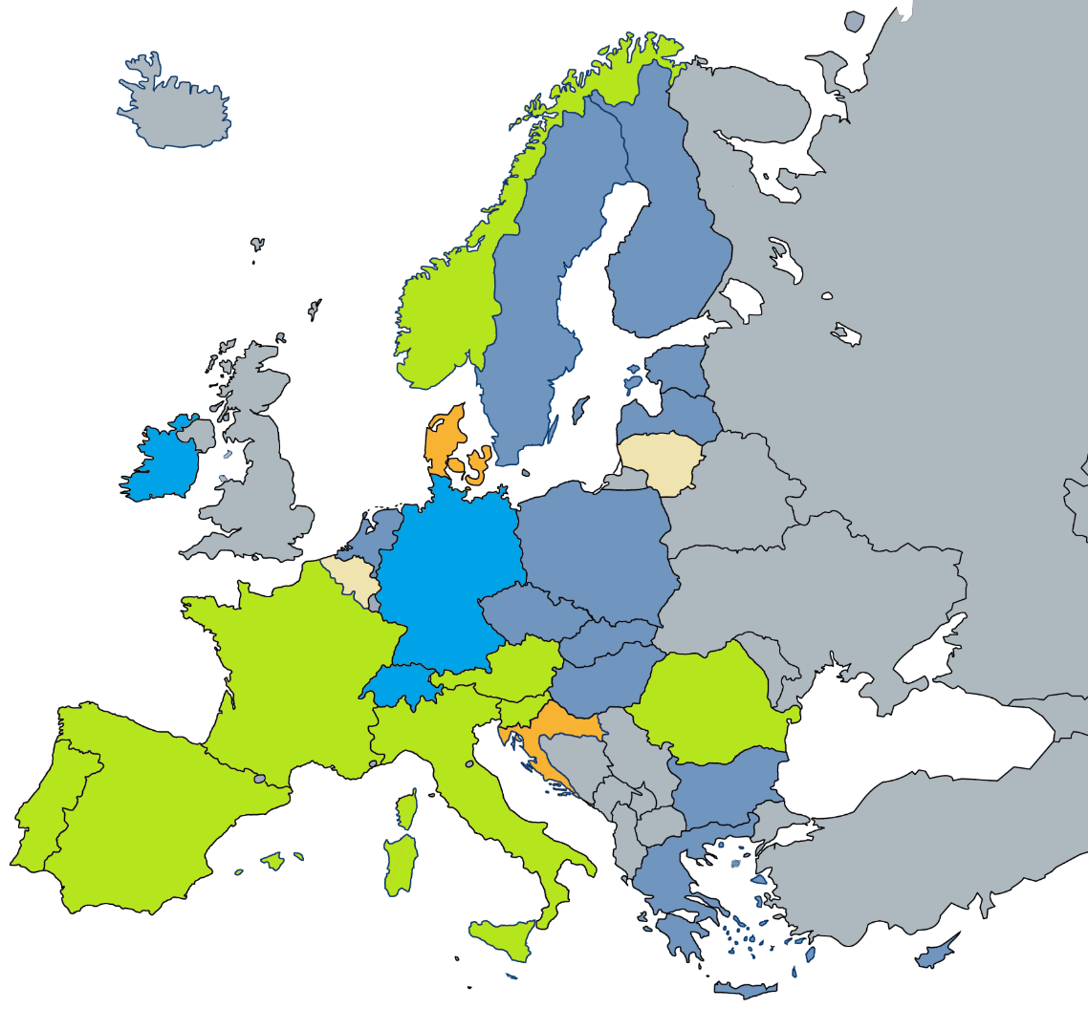
2. Data sets – Mixed methods
Survey & interviews
Online Surveys
Interviews
Process and data analysis
EU countries not covered

Slide 6
2. Data sets – Mixed methods
Interviews
Online Survey
+ & -

Slide 7
3. Some results
https://ec.europa.eu/jrc/en/publication/how-children-10-18-experienced-online-risks-during-covid-19-lockdown-spring-2020
https://ec.europa.eu/jrc/en/publication/eur-scientific-and-technical-research-reports/how-families-handled-emergency-remote-schooling-during-covid-19-lockdown-spring-2020

Slide 8
3.1 Child’s positive attitude about online schooling
Online Survey
-
Vuorikari, R., Velicu, A., Chaudron, S., Cachia, R. and Di Gioia, R., How families handled emergency remote schooling during the time of Covid lockdown in spring 2020 - Summary, EUR 30425 EN, Publications Office of the European Union, Luxembourg, 2020, ISBN 978-92-76-24519-3 (online), doi:10.2760/31977 (online), JRC122303.
Notes:
the family background could influence the way in which the children felt about their abilities and beliefs towards online learning activities. An index of child’s positive attitude towards online schooling was adapted from PISA 2012 (OECD, 2014). Figure 12 shows the mean of answers by country which are further broken down according to families’ household income. A pattern emerges from all participating countries, but Portugal, where children from families with below average household income seem to feel less strongly about their own capacities to cope with online learning activities than the other children.

Slide 9
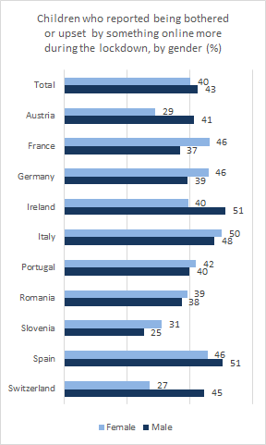
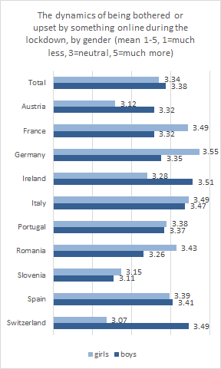
3.2 Being bothered online
By gender and country
Online Survey

Slide 10
3.2 Being bothered online
By gender and country
Online Survey

Slide 11
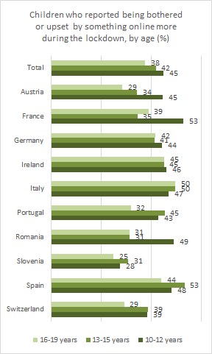
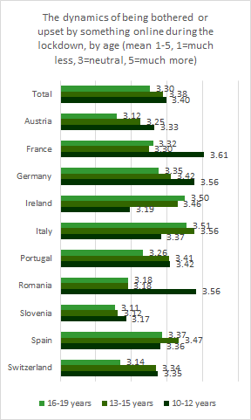
3.2 Being bothered online
By age-groups and country
Online Survey

Slide 12
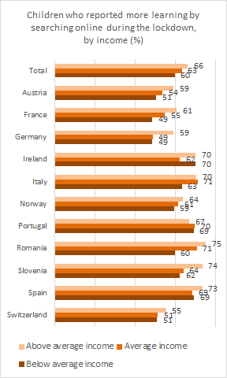
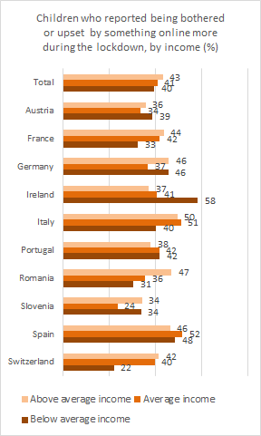
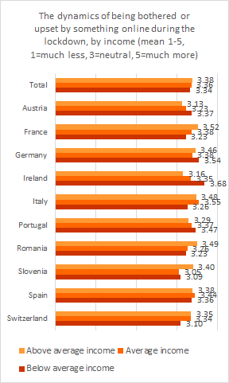
3.2 Being bothered online
By income groups and country
Online Survey

Slide 13
3.3 Sizing Online Learning opportunities
By gender and country
Online Survey

Slide 14
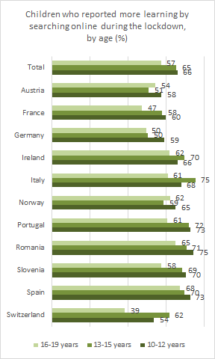
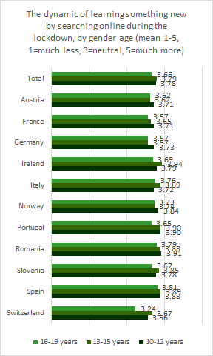
3.3 Sizing Online Learning opportunities
By age-groups and country
Online Survey

Slide 15
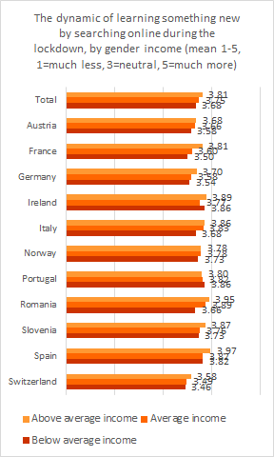
3.3 Sizing Online Learning opportunities
By income groups and country
Online Survey

Slide 16
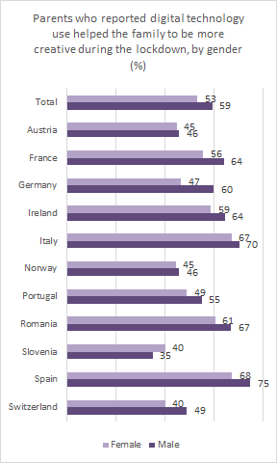
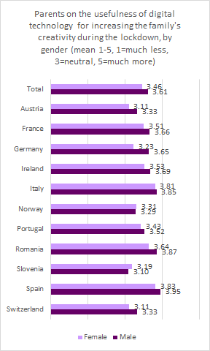
3.4 Parental support in digital creativity
By gender and country
Online Survey

Slide 17
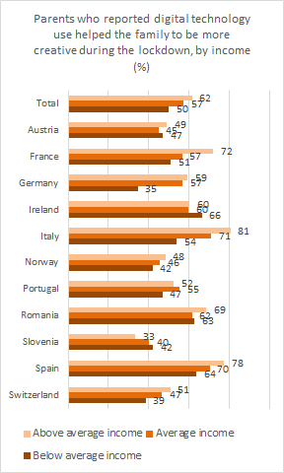
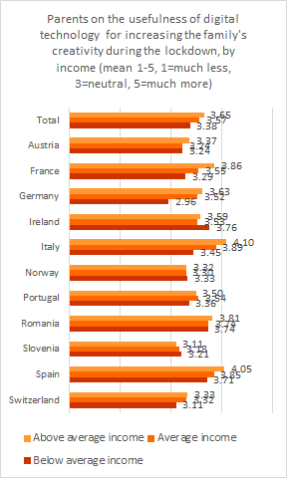
3.4 Parental support in digital creativity
By income groups and country
Online Survey

Slide 18
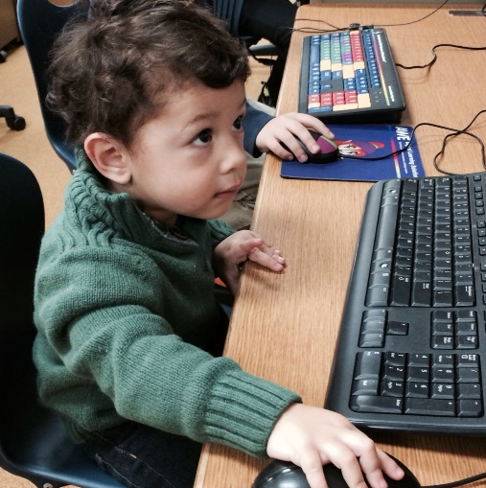
4. Conclusions
Trends
Covid-19 crisis
Increases inequalities in the context of digital education
Granularity
Schift in the tradictional roles in education
Time
CCO https://pxhere.com/en/photo/1631305
CCO https://pxhere.com/en/photo/994283
CCO - snappygoat.com

Slide 19
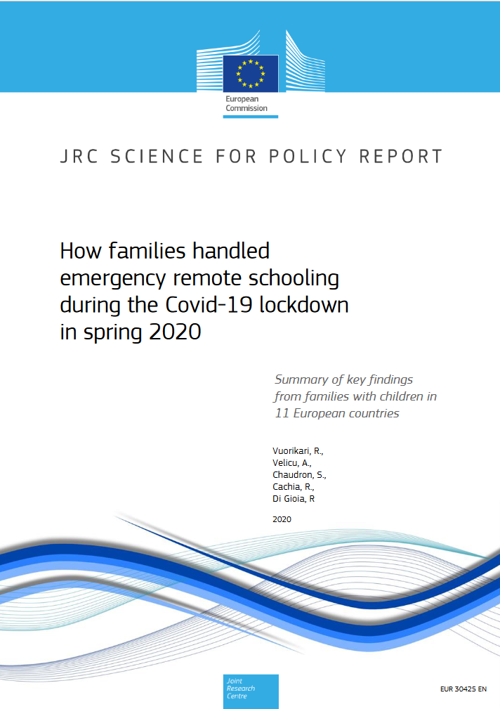
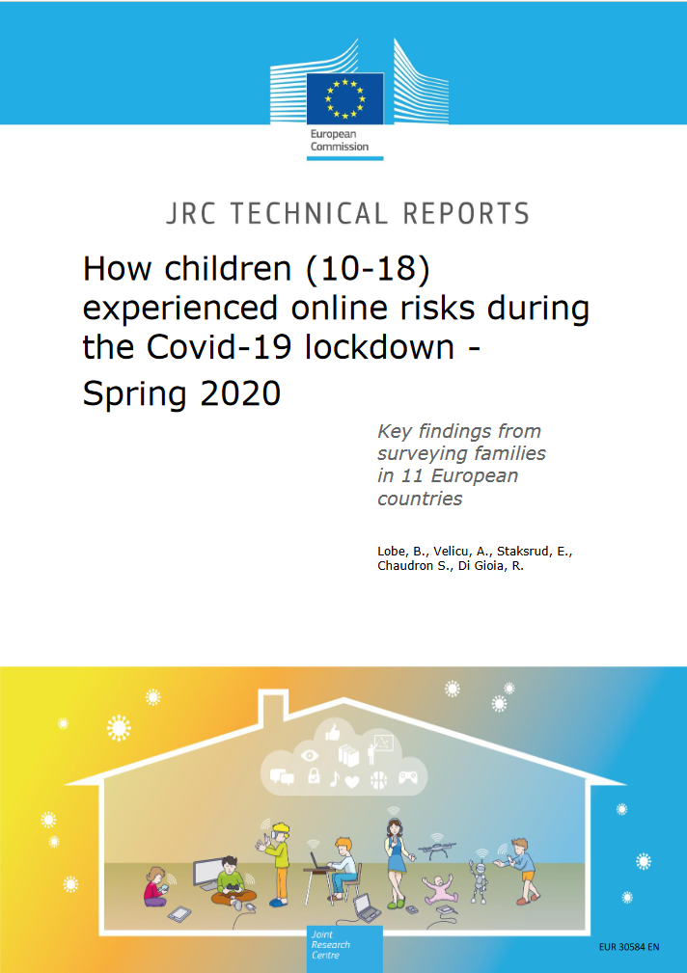
Thank you
https://ec.europa.eu/jrc/en/publication/how-children-10-18-experienced-online-risks-during-covid-19-lockdown-spring-2020
https://ec.europa.eu/jrc/en/publication/eur-scientific-and-technical-research-reports/how-families-handled-emergency-remote-schooling-during-covid-19-lockdown-spring-2020
This presentation has been prepared for internal purposes. The information and views expressed in it do not necessarily reflect an official position of the European Commission or of the European Union.
Except otherwise noted, © European Union (2021). All Rights Reserved
Slide 17: CCO https://pxhere.com/en/photo/1631305; https://pxhere.com/en/photo/994283 & snappygoat.com

Slide 20
Keep in touch
EU Science Hub: ec.europa.eu/jrc
@EU_ScienceHub
EU Science Hub – Joint Research Centre
EU Science, Research and Innovation
EU Science Hub
Notes:
Delete/update as appropriate

