Slide 1
Slideset accompanying the Storyboard for developing Three Rs education resources
Replacement, Reduction, Refinement of animal use in science

Slide 2
The use of animals
The social and scientific context
Theme 1

Slide 3
The use of animals in our society
Some of the uses of animals:
For food
As companions
For entertainment
For labour
For assistance

Slide 4
The use of animals in science
The use of animals in scientific research emerged in the 3rd century BC
In the latter part of the 20th century there was an increase in animal use for scientific testing

Slide 5
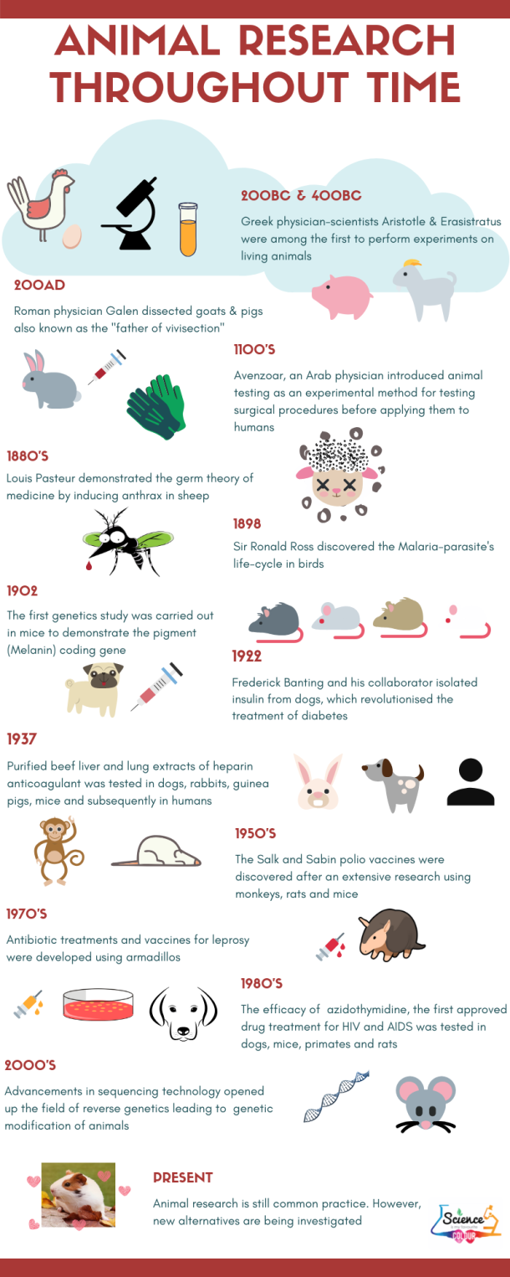
The use of animals History of animal experimentation

Slide 6
Replace, Reduce, Refine The Principle of the Three Rs
Their book promotes an ethical approach to animal use in science through the Three Rs:
Replacing the use of live animals;
Reducing the number of animals used;
Refining the procedures when using animals
In 1959 Russell and Burch publish “The Principles of Humane Experimental Technique”

Slide 7
Replace, Reduce, Refine EU statistics on the use of animals
A challenge:
In 2017 9.39 million animals were used in scientific research in Europe: 61% rats and mice
Dogs, cats and non-human primates represented less than 0.3% of the total number
Member States of the European Union agreed to a Directive in 2010 to move to stop animal testing through the application of the Three Rs

Slide 8
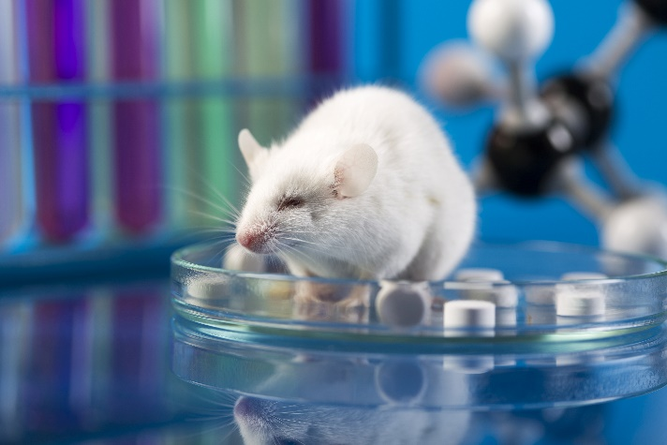
Our relationships with animals European Citizens’ Initiative: Stop Vivisection
We are more aware of the ethical, scientific, legal and economic reasons to minimise the use of animals in scientific research
Strong public opinion against the use of animals in science: European Citizens Initiative of 2015, signed by 1.17 million citizens put pressure on the European Parliament to act

Slide 9
The European Union
and animals used for scientific purposes
Theme 2

Slide 10
Why has the European Union acted? EU law & animal use in science
As early as 1986 the EU adopted legislation to protect animals used for scientific purposes and which introduced the spirit of the Three Rs into legal text.
From 1993 onwards the European Commission had a clear aim to stop the use of animals in testing cosmetics. The European Food Safety Authority (EFSA) also works to minimise the use of animals in food and feed safety assessment.
In 2009 a Regulation 1223/2009 the EU banned the use of animals in the development of “cosmetic products” (and banned also the marketing of cosmetic products that had involved animal testing).

Slide 11
Animal welfare an EU value
The Treaty on the Functioning of the European Union ‘Article 13’ acknowledges the rights of animals:
“In formulating and implementing the Union's agriculture, fisheries, transport, internal market, research and technological development and space policies, the Union and the Member States shall, since animals are sentient beings, pay full regard to the welfare requirements of animals, while respecting the legislative or administrative provisions and customs of the Member States relating in particular to religious rites, cultural traditions and regional heritage.”

Slide 12
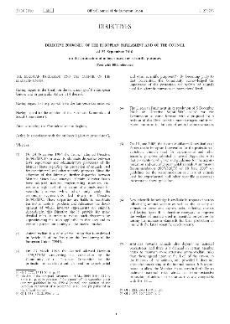
Directive 2010/63/EU protection of animals used for scientific purposes:
subject matter & scope, definitions & requirements
Directive 2010/63/EU concerns the protection of animals used for scientific purposes. This is undertaken through application of the Three Rs and a carefully structured set of processes and actions
Article 1 defines the subject matter and scope including animals not previously covered by EU legislation:
It lays down rules for the protection of animals, including foetuses of mammalian species in their last trimester of development and cephalopods (squid, octopus), for the purposes of research, regulatory testing, higher education and training.

Slide 13
Directive 2010/63/EU protection of animals used for scientific purposes
subject matter & scope, definitions & requirements
Article 3 defines a procedure performed on an animal:
“procedure means any use, invasive or non-invasive, of an animal for experimental or other scientific purposes, with known or unknown outcome, or educational purposes, which may cause the animal a level of pain, suffering, distress or lasting harm equivalent to, or higher than, that caused by the introduction of a needle in accordance with good veterinary practice”

Slide 14
Directive 2010/63/EU Why an EU directive?
The Directive sets objectives to be achieved by all EU Member States through adopting national legislation
“For a directive to take effect at national level, EU countries must adopt a law to transpose it. This national measure must achieve the objectives set by the directive. National authorities must communicate these measures to the European Commission. Transposition must take place by the deadline set when the directive is adopted (generally within two years)”.

Slide 15
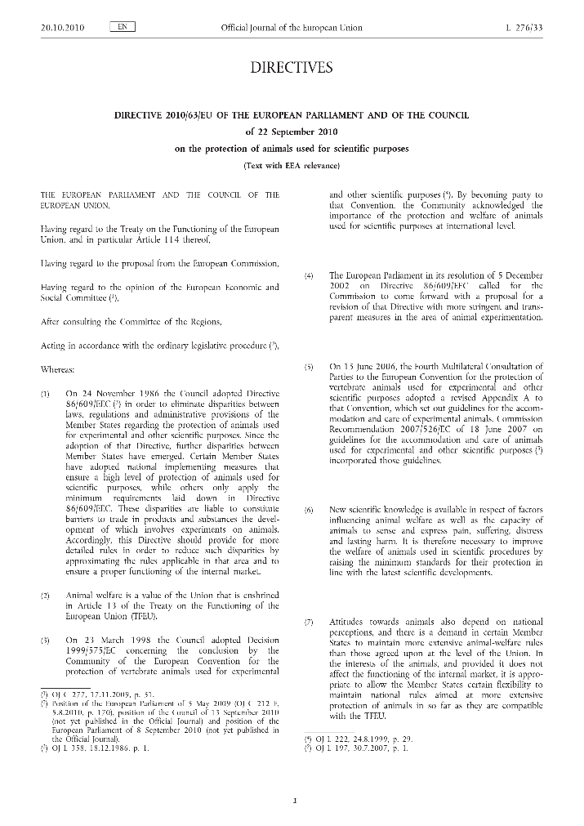
Directive 2010/63/EU and the Three Rs
Directive 2010/63/EU on the protection of animals used for scientific purposes comprehensively revised the 1986 legislation. It is firmly based on the principle of the Three Rs and explicitly makes compliance to the principle a legal obligation.
The final goal of Directive 2010/63/EU is:
“…full replacement of procedures on live animals for scientific and educational purposes as soon as it is scientifically possible to do so.”

Slide 16
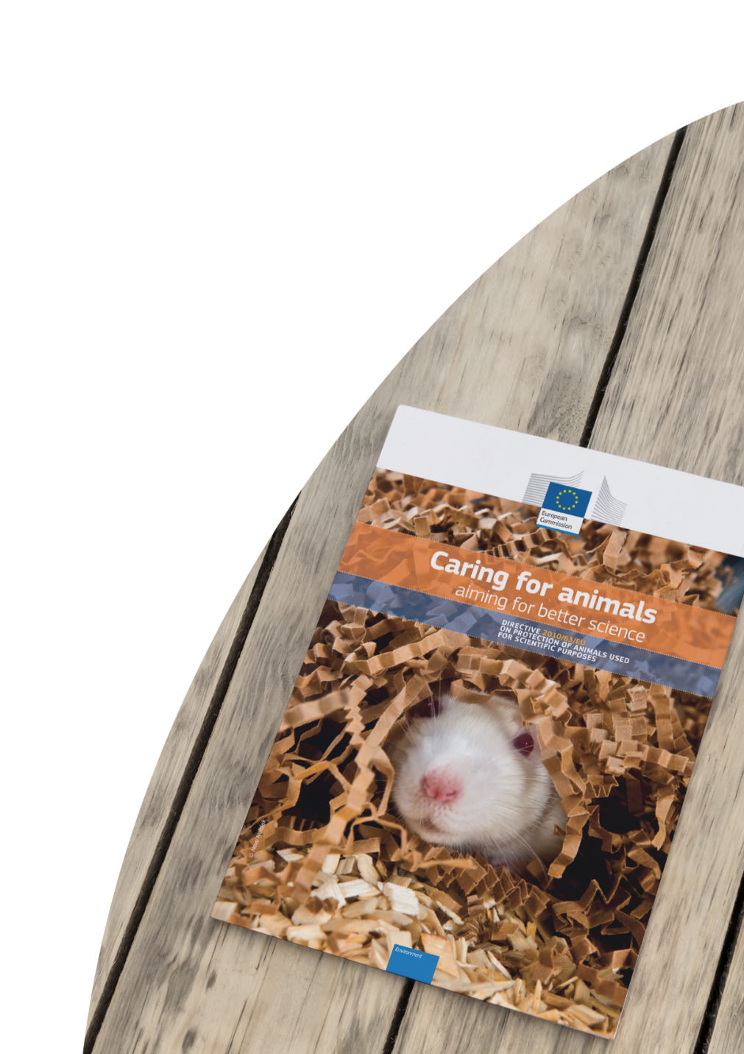
Directive 2010/63/EU new legislation highlights 1/2
The Directive replaced 25-year-old legislation and the scope includes foetuses of mammalian species in their last trimester of development and cephalopods (squid, octopus), animals used for the purposes of basic research, higher education and training.
It lays down minimum standards for housing and care, regulates the use of animals through a systematic project evaluation requiring inter alia assessment of pain, suffering distress and lasting harm caused to the animals.
Projects cannot go ahead without a favourable evaluation and authorisation.

Slide 17
Directive 2010/63/EU new legislation highlights 2/2
The Directive requires regular risk-based inspections and improves transparency through measures such as publication of non-technical project summaries and retrospective assessment.

Slide 18
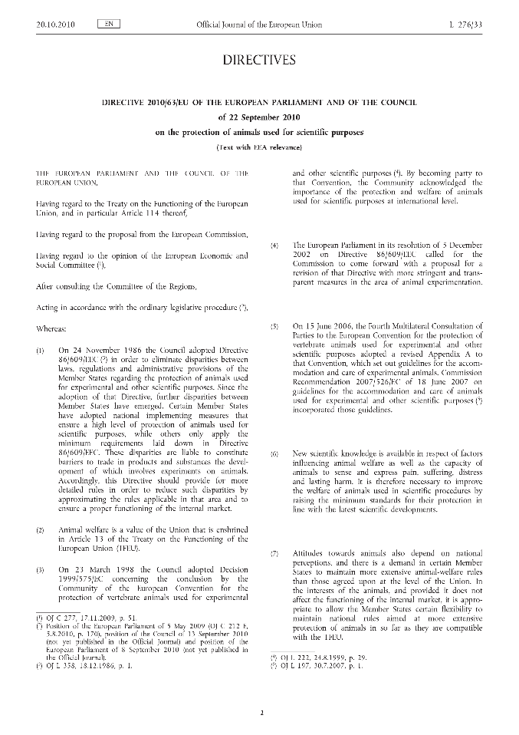
Directive 2010/63/EU application for project authorisation (1/2)
Projects that aim to use animals must submit a fully structured application to be authorised by a ‘competent authority’.
Proposals must identify a person responsible for the overall implementation of the project and its compliance with the authorization.

Slide 19
Directive 2010/63/EU application for project authorisation (2/2)
The competent authority will evaluate the application to ensure that that the harms to the animals are justified by the expected benefits taking into account ethical considerations. The decision must be made within 40 days.
If the evaluation is favourable the competent authority can grant a project authorisation, for a period not exceeding 5 years.

Slide 20
Optimise the tests on animals PREPARE before you ARRIVE
Two methodologies can help projects to address the 3Rs at the stages of being prepared and reported:
PREPARE - a structured checklist for project proposers to go through, with the aim of ensuring that they have addressed every element of a complete application.
ARRIVE - structured guidelines for the reporting of in vivo projects.

Slide 21
Directive 2010/63/EU roles and procedures under the Directive (1/2)
Personnel involved in projects must be specifically trained and supervised.
Each establishment must have a designated veterinarian tasked with advisory duties in relation to the well-being and health of the animals, and to support the work of animal welfare bodies.
The competent authorities must carry out regular inspections of all breeders, suppliers and users, including their establishments.

Slide 22
Directive 2010/63/EU roles and procedures under the Directive (2/2)
To ensure that the public is informed, non-technical project summaries must be published on authorised projects. Some projects must in addition be assessed retrospectively once they have been completed.
Member States establish National Committees for the protection of animals used for scientific purposes, and to give advice to the competent authorities and animal-welfare bodies.

Slide 23
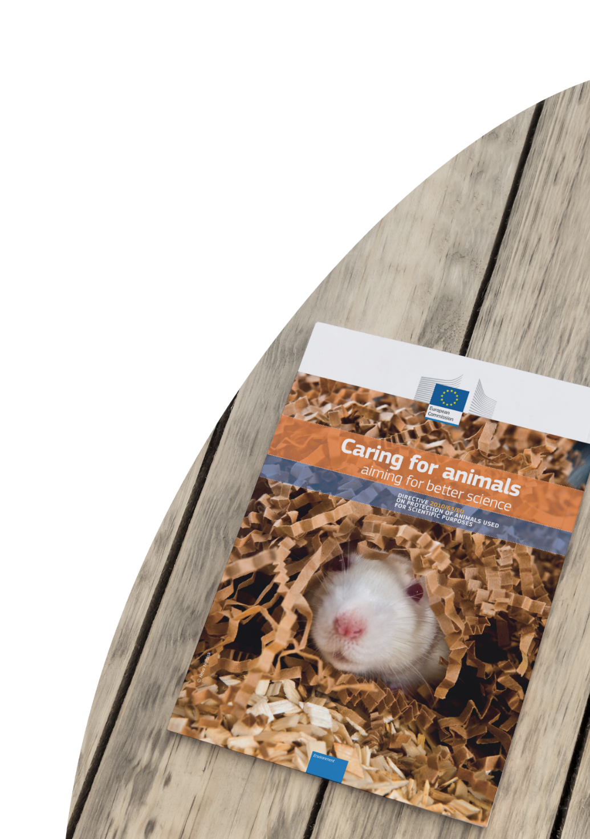
The EU Directive European Union Reference Laboratory for alternatives to animal testing (EURL ECVAM)
Directive 2010/63/EU includes a formal legal base for the European Union Reference Laboratory for alternatives to animal testing (EURL ECVAM) at the Joint Research Centre. The mandate is to advance the Three Rs through:
- conducting research and collaborating in EU and international research initiatives;
- coordination and undertaking of validation studies of alternative methods for the safety assessment of chemicals;
- dissemination of information and sharing of knowledge across disciplines and sectors; and
- promotion of alternative methods and the Three Rs in an international context.

Slide 24
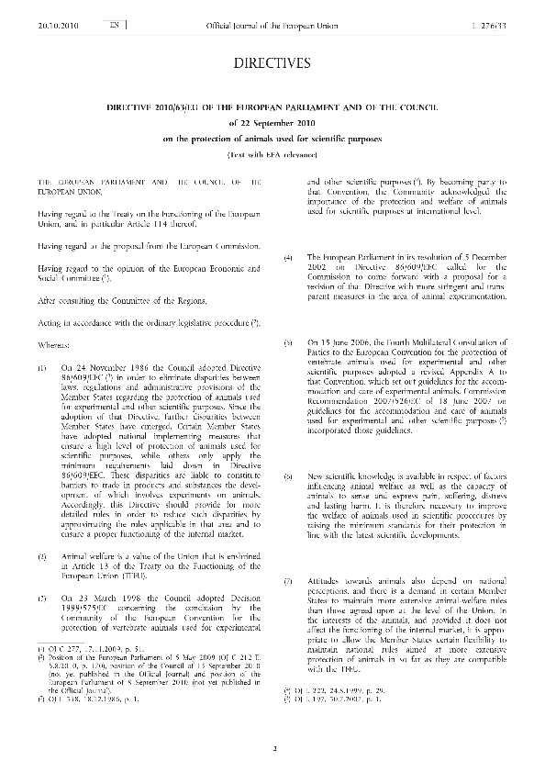
Directive 2010/63/EU implementation at Member State level The PARERE network
EURL ECVAM promotes dialogue between legislators, regulators, and all relevant stakeholders.
Dialogue is undertaken through the PARERE (Preliminary Assessment of Regulatory Relevance) Network, to which Member States identify a single point of contact to provide advice on the regulatory relevance of alternative approaches proposed for validation.”

Slide 25
Directive 2010/63/EU implementation at Member State level – Validating alternatives through EU-NETVAL
Member States are encouraged to nominate specialised laboratories to support EURL ECVAM’s alternative method validation studies
This network of labs is known as EU-NETVAL and is coordinated by EURL ECVAM
Members are selected against pre-defined eligibility criteria and endorsed by the National Contact Points for the Directive
Currently there are 35 member labs

Slide 26
Keep in touch
EU Science Hub: ec.europa.eu/jrc
@EU_ScienceHub
EU Science Hub – Joint Research Centre
EU Science, Research and Innovation
Eu Science Hub

Slide 27
Thank you
© European Union 2021
Unless otherwise noted the reuse of this presentation is authorised under the CC BY 4.0 license. For any use or reproduction of elements that are not owned by the EU, permission may need to be sought directly from the respective right holders.
Slide 8: source: stock.adobe.com; Slide 20: source: stock.adobe.com

