Slide 1
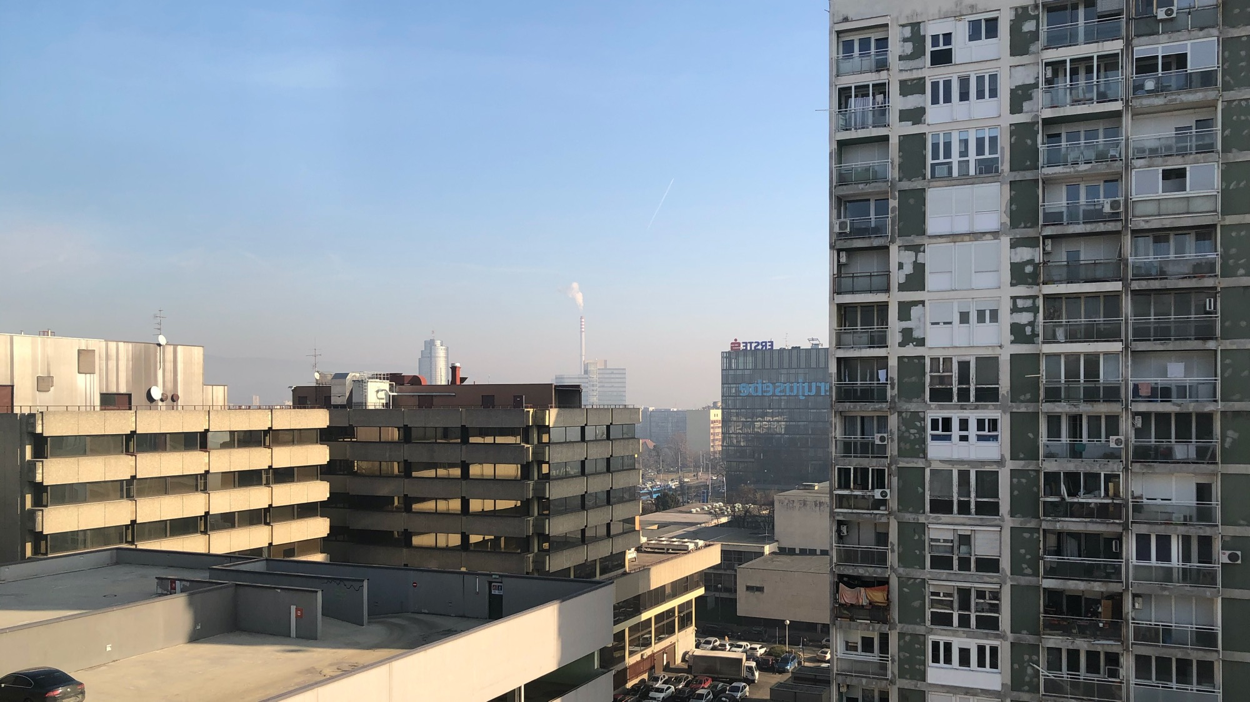




Just transitions in the EU energy sector: a critical perspective
Stefan Bouzarovski, University of Manchester

Slide 2
Starting points
We need just transitions that can address:
The fundamental structural drivers of energy poverty
Both the subjects and objects of energy interventions
The rise of new and entrenchment of existing inequalities in the movement towards a low-carbon energy system

Slide 3

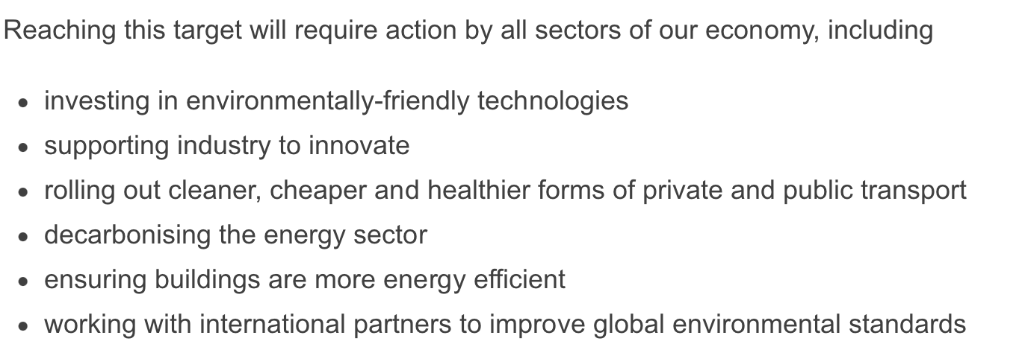
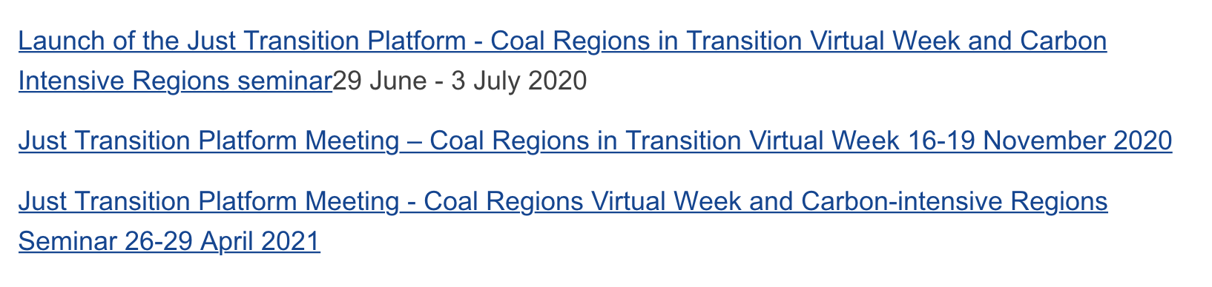
Just transitions – a critique

Slide 4
Policy issues – energy poverty
Lack of binding targets in most recent policies
Formulation of energy poverty as a technical rather than political challenge
Best practice evaluation, promotion and dissemination
Widely varying responses across Member States, regions and cities – often as a result of limited resources, awareness and capacity

Slide 5
EU energy poverty policy: developments
Growing recognition and integration of energy poverty policy in the activities of EU institutions
Extensive network of stakeholders active on the subject
Improved monitoring, reporting and understanding: EU Energy Poverty Observatory
Clean Energy Package -> Renovation Wave
Commission Recommendation on energy poverty

Slide 6
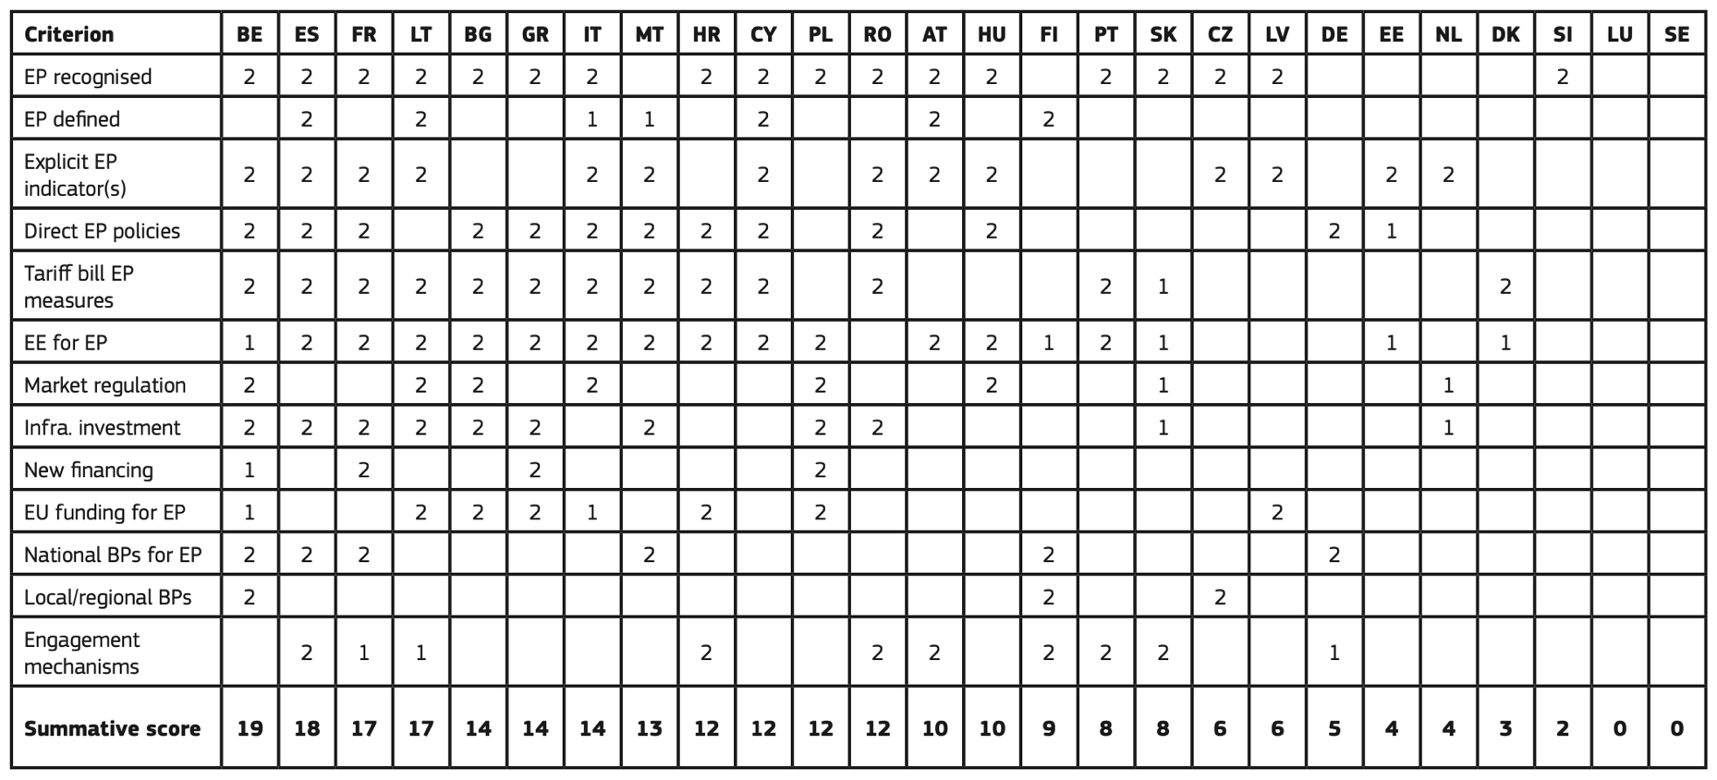
A summative assessment of energy poverty considerations across the NECPs (Bouzarovski et al 2020)

Slide 7
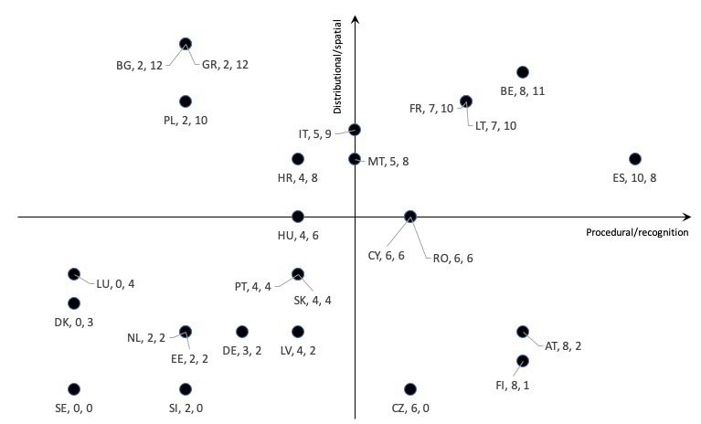
An appraisal of the NECPs based on ‘access to justice’ (x-axis) and ‘access to resources’ (y-axis).
https://doi.org/10.3390/en14040858

Slide 8
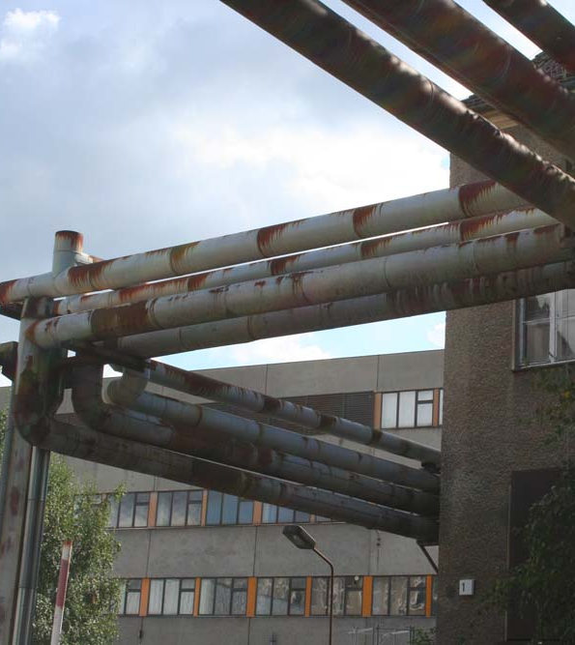
Addressing energy poverty in Europe in the just transition context – key challenges
Data: gender, ethnicity, inadequately cooled homes, sub-national level indicators and observatories, energy ‘basket’
Nexus connections: transport, food, water, urban and regional planning
Co-operation and participation: Engagement with the social sector, representation of vulnerable groups
Just transitions: Integration with energy poverty

Slide 9
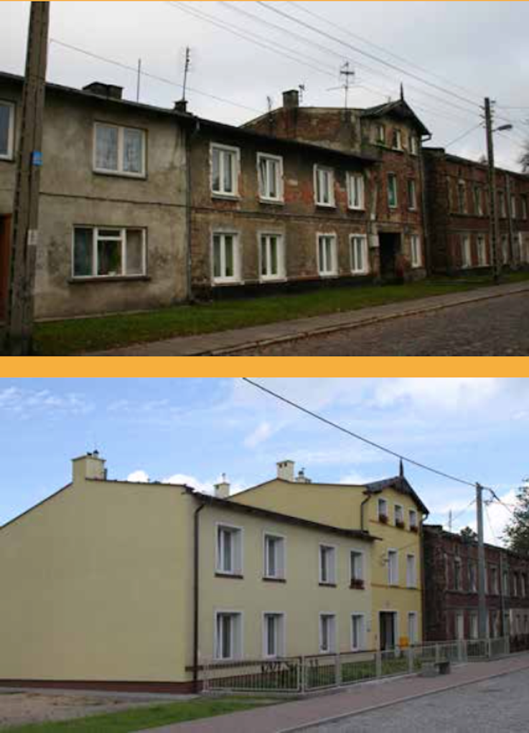
Low carbon gentrification
Bouzarovski S, Frankowski J, Tirado Herrero S (2018) Low-carbon gentrification: when climate change encounters residential displacement. International Journal of Urban and Regional Research 42: 845-863
An eco social paradox: Social and environmental benefits of building renovation are compromised by the effect of energy-efficient retrofitting on socio-spatial urban structures and segregation patterns (Grossmann and Huning, 2015)
In Gdańsk, 2005-2014:
Full retrofitting of 29 residential buildings
Changes in green spaces
New social housing (22 households)
Forced residential moves in 2010 and 2011
25 households were ‘renovicted’
43 households were displaced indirectly
Image source: City of Gdańsk

Slide 10
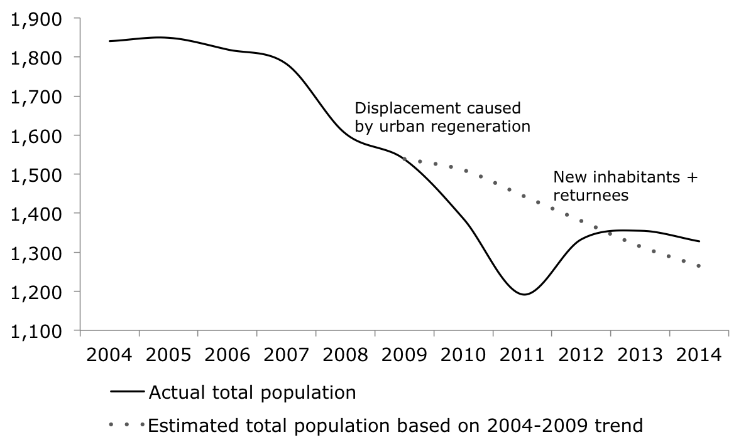
Bouzarovski et al 2018

Slide 11
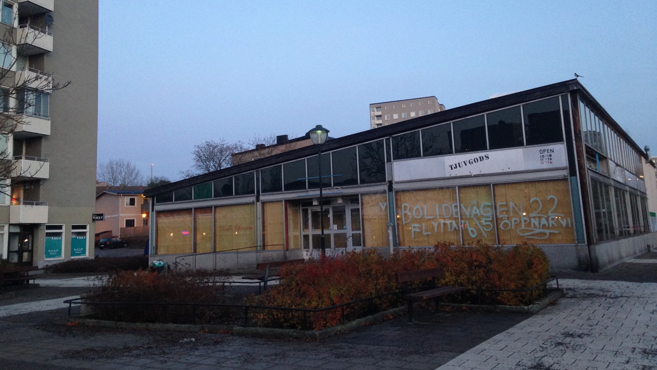
Contesting ‘renovictions’
Evictions following energy efficiency interventions in rented housing
Opposition to the Grow Smarter project in a Stockholm neighbourhood
Community organizing and occupations
Årsta, Stockholm. Photo by Stefan Bouzarovski

Slide 12
Towards a just transition: reflections and priorities
Visibility and evidence: gender, ethnicity, inadequately cooled homes, sub-national level indicators and observatories, relative/absolute measures and energy ‘baskets’
Nexus connections: transport, food, water, urban and regional planning
Politicization and recognition: Engagement with the social sector, representation of vulnerable groups, stigmatization and precarity
Inclusion and diversity: Grassroots and everyday transformations

Slide 13
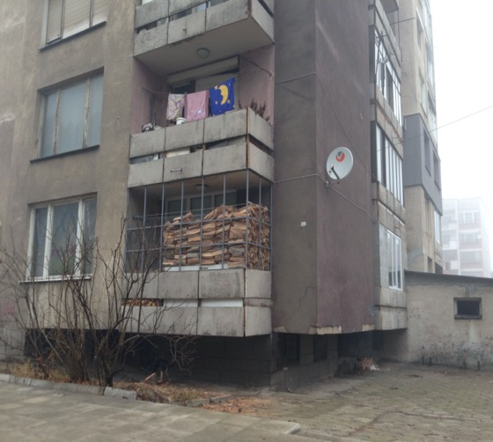

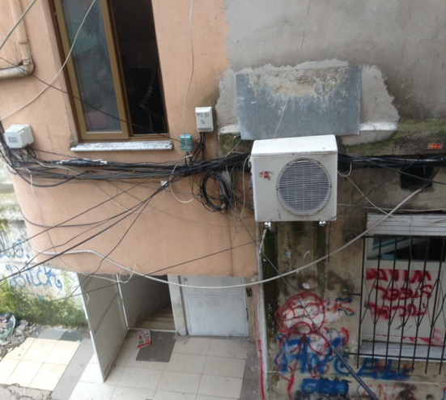
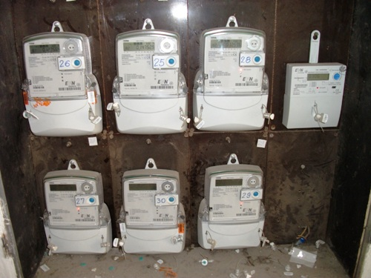

THANK YOU stefanbuzar

