Slide 1
The impact of COVID-19 on the gender division of childcare in Hungary
Eva Fodor
CEU Democracy Institute
February 10, 2021

Slide 2
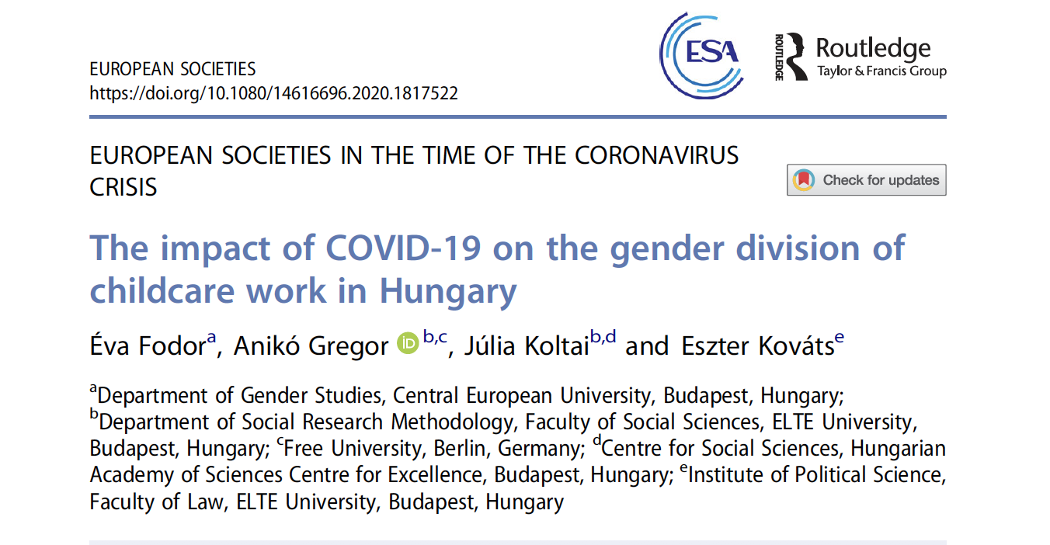

Slide 3
What we know: Most childcare is done by women in Hungary. The volume of childcare has increased during the lockdown period. Research question: Did its distribution change within the family? If so, uniformly? What about specifically among people who are working from home?

Slide 4
Why is this important?
Mothers dedicate 2-3 times more time to childcare than fathers (and also to household duties).
Fathers’ involvement has increased, but a large gap remained
Little governmental encouragement to close this gap in HU
Domestic work may be a hindrance to women’s successful career/ ability to keep their jobs (“motherhood penalty”)
Could availabiliity matter in the principles of dividing care work?

Slide 5
“Inequalities during the Coronavirus in Hungary Survey Research”
Nationally representative sample of 18-65 year olds, N= 1900
Conducted via phone interviews between May 26-29,2020 (11th week of lockdown)
Only included parents of children under 18 (N=627).
Used a series of simple linear regressions
Explanatory variable: “Before the coronavirus epidemic, how many hours a week did you spend in. total on parenting activities such as playing, storytelling, learning, talking, dressing, feeding?” and same with “During the the restrictive measures introduced as a result of the coronavirus epidemic…”
Independent variable of main interest: gender
Main controls: age, education, settlement type, employment status, working in white collar job, working in home office, egalitarian vs conservative gender role attitudes

Slide 6
Findings:
Both men and women increased time input into childcare;
Women added a lot more hours than men (even among similar men and women);
Especially high was the increase and the gender gap among highly educated couples;
Home office work does not change this: moms in home office did MUCH more childcare than dads in home office.

Slide 7
Both men and women increased input into childcare by about 35%, but women added a lot more time than men
This is true even if we control for age, settlement type, employment status, job type, education, gender ideology, home office work.

Slide 8
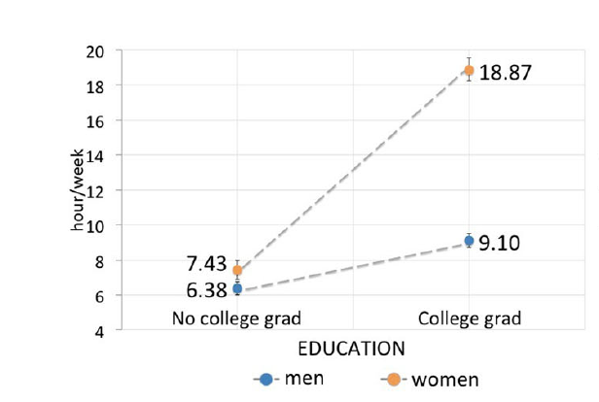
Especially high was the gender gap in the increase among highly educated couples
Predicted change in the number of hours dedicated to childcare during pandemic lockdowns compare dto before, controlling for all other control variables

Slide 9
Educated urban women stand out Change in the number of hours per week dedicated to childcare from before to during lockdown

Slide 10
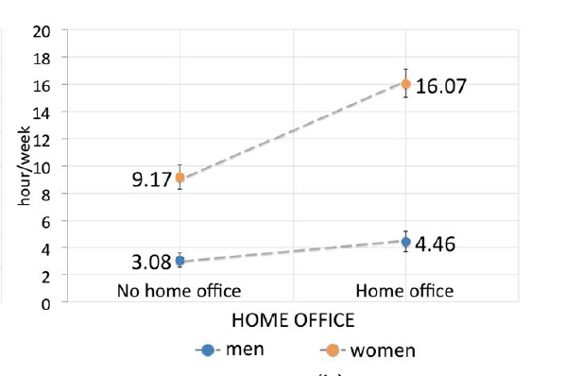
Even among men and women both working in home offices, women increased childcare input more
Predicted change in the number of hours dedicated to childcare during pandemic lockdowns compare dto before, controlling for all other control variables

Slide 11
Consequences:
Mothers of schoolage children are more likely to have lost their jobs than women without children and men in Hungary
Women’s level of anxiety /mental health took a bigger hit- at least some dimensions
Anecdotal evidence: little change in gender division of labor and in parents ability to negotiate flexibility in work time/ work location arrangements

Slide 12
Thank you!

Slide 13
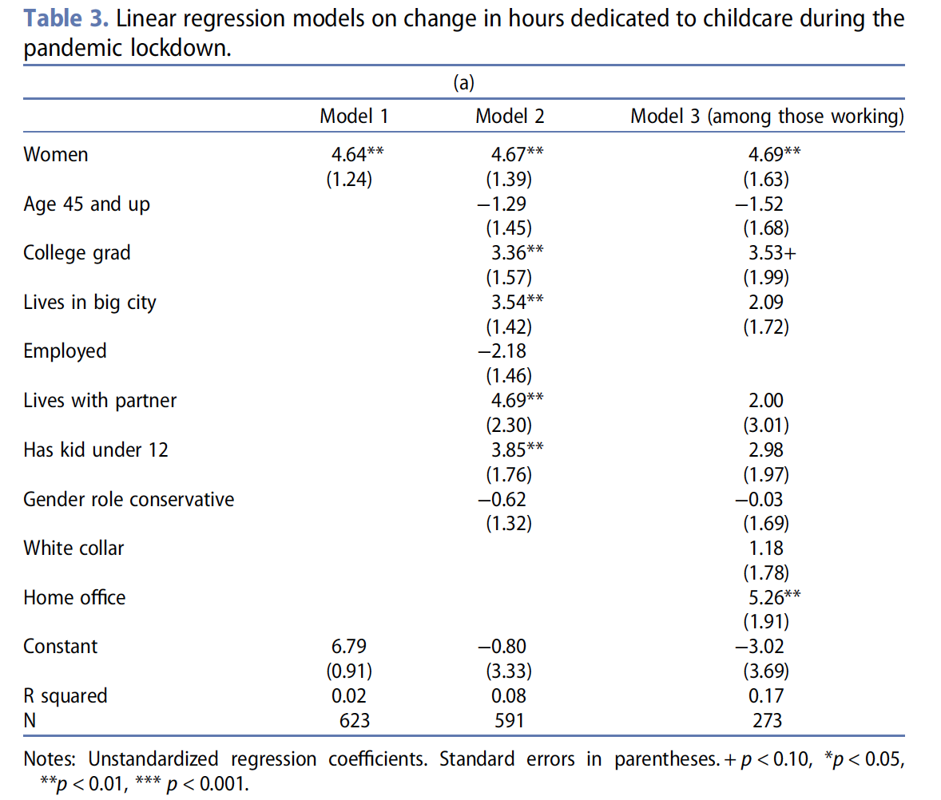
Appendix

